Slide 1
CISC2003 OOP AND DATA STRUCTURES
1
Lab 10
TA: Wu Qingtian
Email: yc07452@umac.mo
Notes:
Chapter 1 - 1

Slide 2
Outline
2
Get familiar with tree and binary tree
Get familiar with three binary tree traversal approaches: preorder, inorder, postorder
Notes:
Chapter 1 - 2

Slide 3
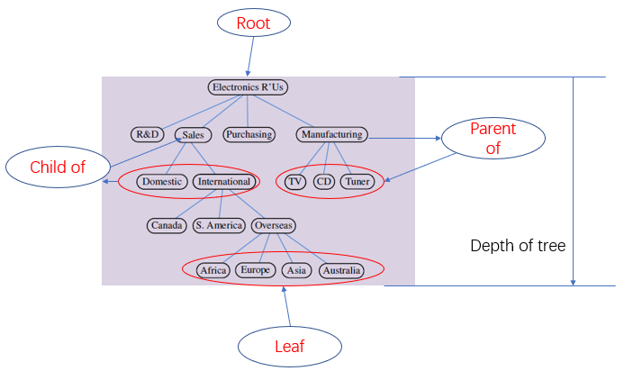
Tree
3
General concepts of Tree family:
Notes:
Chapter 1 - 3

Slide 4
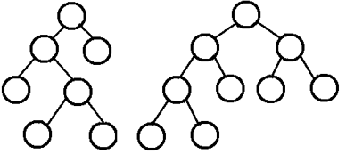
Binary Tree
4
1. Every node has at most two children.
2. Each child node is labeled as being either a left child or a right child.
3. A left child precedes a right child in the order of children of a node. (以左为贵)
corresponding codes refer to lecture notes Tree Structures.
Notes:
Chapter 1 - 4

Slide 5
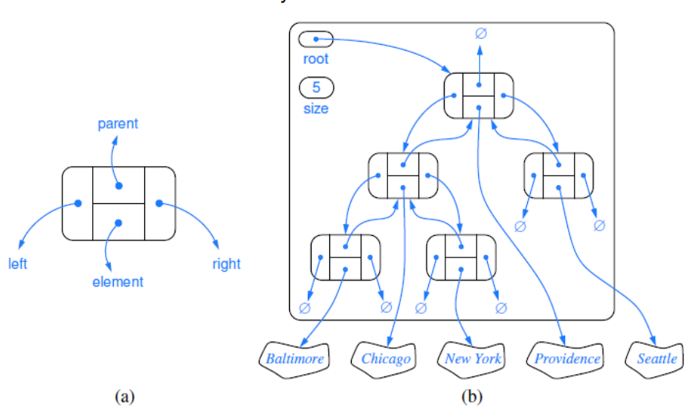
Binary tree based on linked structure
5
Notes:
Chapter 1 - 5

Slide 6
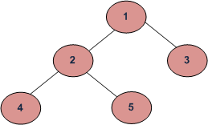
Tree Traversal
6
Preorder (Root, left, Right)
Inorder (Left, Root, Right)
Postorder (Left, Right, Root)
postorder(root)
preorder(root)
{
print(root)
preoreder(root.left)
preoreder(root.right)
}
inorder(root)
{
inoreder(root.left)
print(root)
inoreder(root.right)
}
{
postorder(root.left)
postorder(root.right)
print(root)
}
1 2 4 5 3
4 2 5 1 3
4 5 2 3 1
Notes:
Chapter 1 - 6

Slide 7
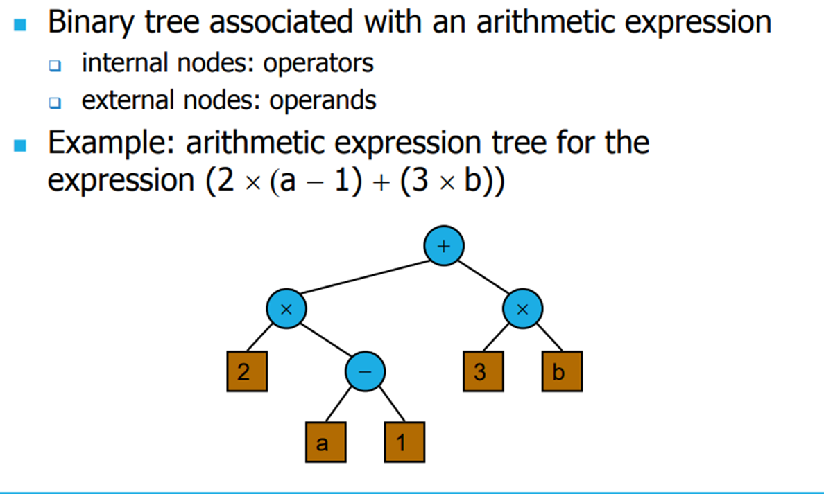
Arithmetic Expression
7
Notes:
Chapter 1 - 7

Slide 8
Practice
8
Build the binary tree representation of the following arithmetic expression
Notes:
Chapter 1 - 8

Slide 9
Exercise
9
Using inorder to print out the arithmetic expressions in binary tree
[Submission Tips]
Please upload two files:
Source code package: all sub-file(s) in *. java;
A pdf report, the format can refer to Assignment 1 template.
Having code comments and result screenshots can get higher score.
Do not copy codes from others, or both you two will lose scores.
Submission deadline: 11:50 pm this Wednesday.
Notes:
Chapter 1 - 9

